Slide 1

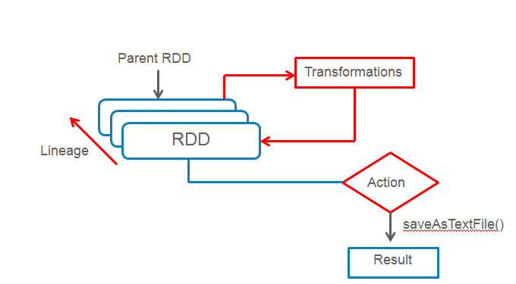
Spark
https://bit.ly/4ihJHLC

